Slide 1
Horace 4 issues from user experience and Horace 4.1 highlights
Use filebacked objects properly
instrument view cut
Combine multiple filebacked operations together (sqw_op). Background calculations and removal
Random pixels transformation. sqw_op_bin_pixels
Combine random cuts together. sqw_op_bin_pixels(… -combine)
sqw_op_bin_pixels vs SymOp
Current development and plans for a future.

Slide 2
Horace 4 issues from user experience and Horace 4.1 highlights
Fully fledged filebacked objects (almost)
hor_config with properties:
mem_chunk_size: 10000000
fb_scale_factor: 10
Filebacked if:
Number of pixels > mem_chunk_size*fb_scale_factor
ss = sqw()
0-dimensional object:
-------------------------
.
.
Extent of data:
Number of spe files: 0
Number of pixels: 1
.
.
Object is: memory based
ss = sqw('Fe_ei800_align.sqw’)
4-dimensional object:
-------------------------
.
.
Extent of data:
Number of spe files: 186
Number of pixels: 1286313318
.
.
Object is: filebacked

Slide 3
Horace 4 issues from user experience and Horace 4.1 highlights
Filebacked if:
Number of pixels > mem_chunk_size*fb_scale_factor
Filebacked objects: tip and tricks:
faster
sq_obj = sqw('Fe_ei800_align.sqw’);
w2a = cut(sq_obj,proj,….);
w2b = cut(sq_obj,proj,….);
sq_file = 'Fe_ei800_align.sqw’;
w2a = cut(sq_file,proj,….);
w2b = cut(sq_file,proj,….);
If cut result is filebacked it will disappear with object
save(w2a,’file_with_sqw.sqw’)
save(’file_with_sqw.mat’,’w2a’)

Slide 4
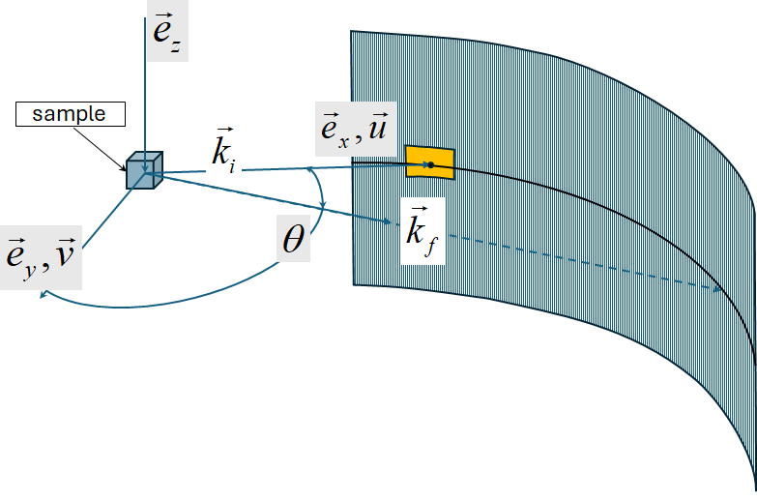
Data Diagnostics: Instrument view cut
Horace Instrument view cut – Mantid instrument view with difference
Normally Horace works with scattering function build in reciprocal coordinate system related to a crystal.
If sample is not sufficiently large to allow neutrons thermalization or instrument have various problems with
its detectors or background scattering, some scattering artefacts may add noise or unrelated signals to
measured function. These artefacts will have spherical symmetry around the beam direction.
To clearly identify such artefacts one may use instrument_view_cut
Interface to cut with kf_sphere_proj
which you should not use in your cuts. (Not ready, not requested)
Full SQW object operation
wout = instrument_view_cut(sqw_source,[0,theta_step,theta_max],[En_min,En_step,En_max]);

Slide 5
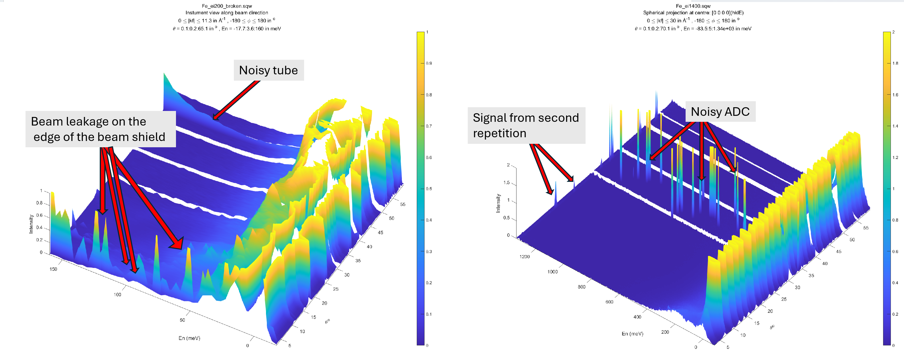
Horace 4 issues from user experience and Horace 4.1 highlights
Horace Instrument view cut – Mantid instrument view with difference
wout = instrument_view_cut(sqw_source,[0,theta_step,theta_max],[En_min,En_step,En_max]);

Slide 6
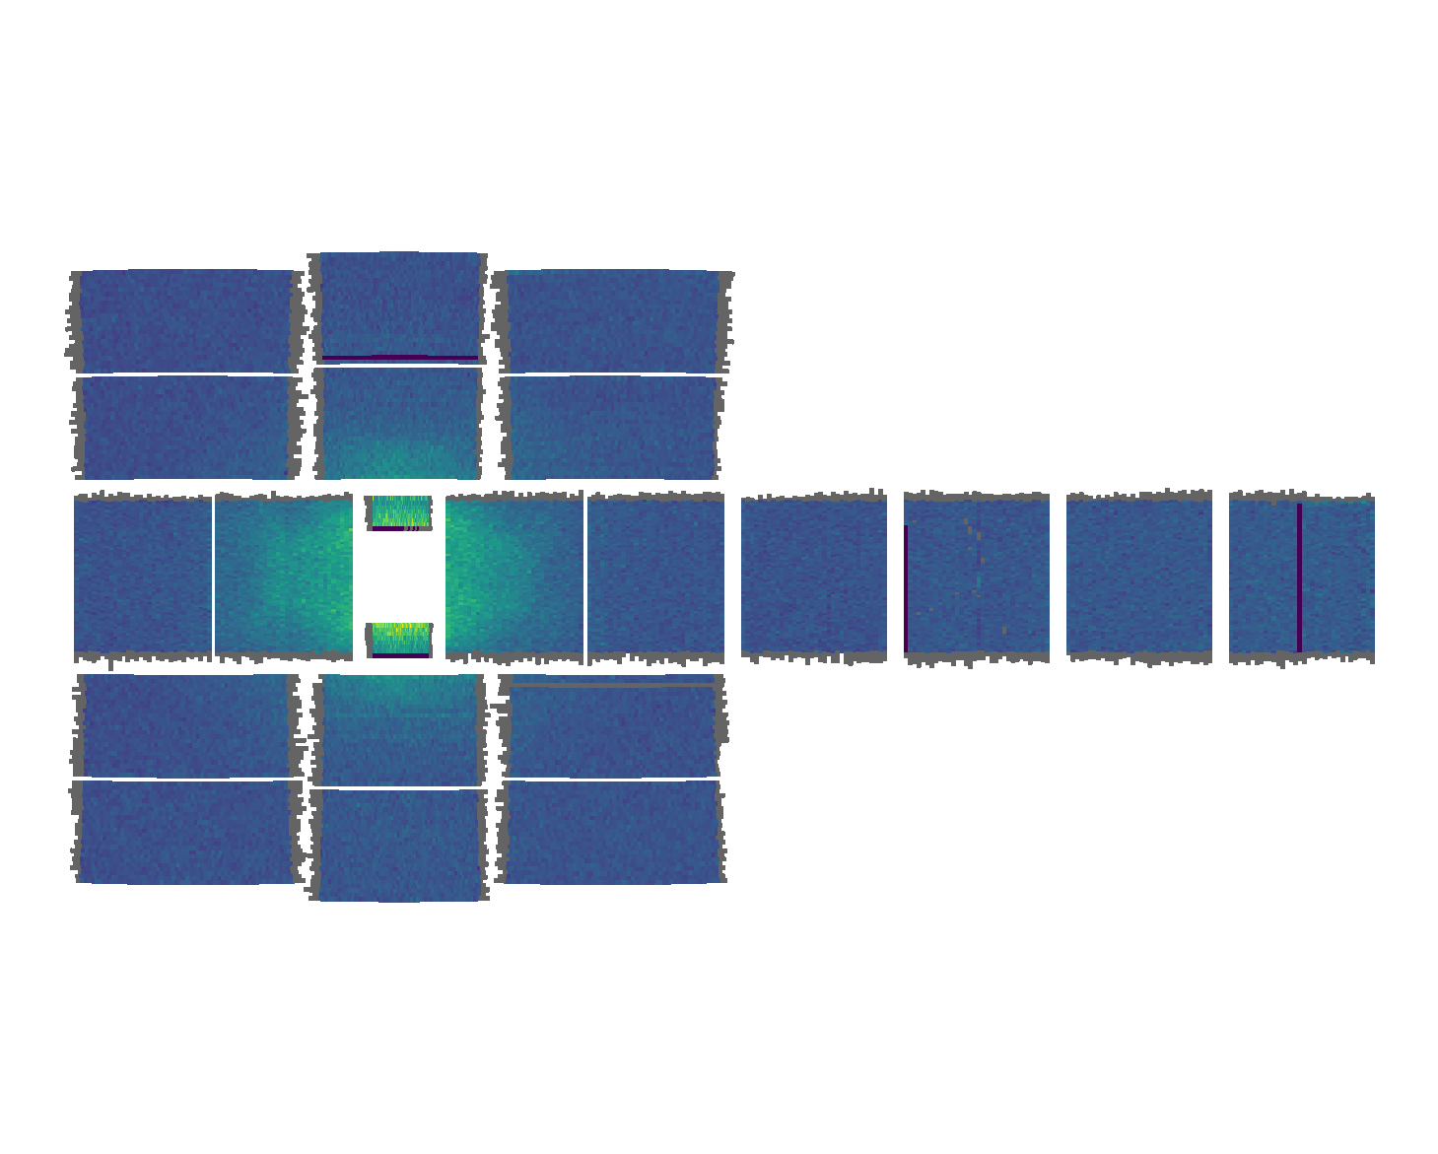
Horace 4 issues from user experience and Horace 4.1 highlights
Data Diagnostics: Instrument view cut
Normally Horace works with scattering function build in reciprocal coordinate system related to a crystal.
If sample is not sufficiently large to allow neutrons thermalization or instrument have various problems with
its detectors or background scattering, some scattering artefacts may add noise or unrelated signals to
measured function. These artefacts will have spherical symmetry around the beam direction.
To clearly identify such artefacts one may use instrument_view_cut
Full SQW object operation
https://abuts.github.io/Horace/v4.1.0/manual/Data_diagnostics.html#instrument-view-cut

Slide 7
sqw_op :-> gateway for unary & binary operations overs sqw files
Further expansion of sqw_eval algorithm
Horace has reach set of unary and binary operations which allow user to modify and analyse his data.
Unary and binary operations in Horace-4 are performed on the basis of PageOp superclass algorithm,
which provide common interface to performing all operation affecting whole sqw objects in memory
or on file system.
If sqw objects are filebased and can not be placed in memory, a PageOp-based algorithm scans file by
loading in memory every page of pixels, applying appropriate operation to this page and calculating pixel’s
averages which form an sqw object image and producing final filebacked result with image in memory.
This all works fine, but an operation, e.g. :
sqw3 =cos(sqw1) ² + sin(sqw1)²;
performs 5 scans of the files (if pixels are stored in files) until the result is produced. This is theoretically fine,
but practically very inconvenient if you work with large files.
Advanced users now have way around this, by using sqw_op algorithm

Slide 8
Horace 4 issues from user experience and Horace 4.1 highlights
sqw_op :-> gateway for unary & binary operations overs sqw files
ADVANCED!!!
Full SQW object operation
w2_14 = instrument_view_cut(sqw_file_or_obj,[0,0.2,70],4);
x1 = w2_14.p{1};
x2 = w2_14.p{2};
F = griddedInterpolant({x1,x2},w2_14.s);
sqw1400_no_bg = sqw_op(sqw_file_or_obj,@remove_background,{w2_14,F},'outfile',target_filename);
function sig_var = remove_background(pageop_obj,bg_data,bg_model,rlu)
% retrieve page of pixel data in Crystal Cartesian coordinate system
data = pageop_obj.page_data;
% 2D background
pix = bg_data.proj.transform_pix_to_img(data(1:5,:));
bg_signal = bg_model(pix(2,:),data(4,:));
sig_var = data([8,9],:);
sig_var(1,:) = data(8,:)-bg_signal;
over_compensated = sig_var(1,:)<0;
sig_var(2,over_compensated) = 0;

Slide 9
Horace 4 issues from user experience and Horace 4.1 highlights
sqw_op :-> gateway for unary & binary operations overs sqw files
Background data
ADVANCED!!!
Full SQW object operation
w2_14 = instrument_view_cut(sqw_file_or_obj,[0,0.2,70],4);
x1 = w2_14.p{1};
x2 = w2_14.p{2};
F = griddedInterpolant({x1,x2},w2_14.s);
sqw1400_no_bg = sqw_op(sqw_file_or_obj,@remove_background,{w2_14,F},'outfile',target_filename);
function sig_var = remove_background(pageop_obj,bg_data,bg_model,rlu)
% retrieve page of pixel data in Crystal Cartesian coordinate system
data = pageop_obj.page_data;
% 2D background
pix = bg_data.proj.transform_pix_to_img(data(1:5,:));
bg_signal = bg_model(pix(2,:),data(4,:));
sig_var = data([8,9],:);
sig_var(1,:) = data(8,:)-bg_signal;
over_compensated = sig_var(1,:)<0;
sig_var(2,over_compensated) = 0;

Slide 10
Horace 4 issues from user experience and Horace 4.1 highlights
sqw_op :-> gateway for unary operations overs sqw files
ADVANCED!!!
Full SQW object operation
w2_14 = instrument_view_cut(sqw_file_or_obj,[0,0.2,70],4);
x1 = w2_14.p{1};
x2 = w2_14.p{2};
F = griddedInterpolant({x1,x2},w2_14.s);
sqw1400_no_bg = sqw_op(sqw_file_or_obj,@remove_background,{w2_14,F},'outfile',target_filename);
Background model
function sig_var = remove_background(pageop_obj,bg_data,bg_model,rlu)
% retrieve page of pixel data in Crystal Cartesian coordinate system
data = pageop_obj.page_data;
% 2D background
pix = bg_data.proj.transform_pix_to_img(data(1:5,:));
bg_signal = bg_model(pix(2,:),data(4,:));
sig_var = data([8,9],:);
sig_var(1,:) = data(8,:)-bg_signal;
over_compensated = sig_var(1,:)<0;
sig_var(2,over_compensated) = 0;

Slide 11
Horace 4 issues from user experience and Horace 4.1 highlights
sqw_op :-> gateway for unary & binary operations overs sqw files
ADVANCED!!!
Full SQW object operation
Any operation over sqw object which does not change pixels coordinates
sqw_op(…, @remove_ background,…)

Slide 12
Horace 4 issues from user experience and Horace 4.1 highlights
sqw_op_bin_pixes :-> random operations overs sqw files
ADVANCED!!!
Full SQW object operation

Slide 13
Horace 4 issues from user experience and Horace 4.1 highlights
sqw_op_bin_pixes :-> Build Q>cut-off background in
first BZ
ADVANCED!!!
Full SQW object operation
sqw400meV_bg = sqw_op_bin_pixels(src400, @build_bz_background, {r_cut2,rlu}, cut_range{:}, '-nopix');
sqw_op parameters
Cut parameters: {proj, [q1_min,step,q1_max], [q2_min,step,q2_max] …}
optional

Slide 14
sqw_op_bin_pixes :-> Build Q>cut-off background in
first BZ
function data = build_bz_background(pageop_obj,r2_ignore,rlu)
%build_bz_background used to build background out of q-values beyond of the cut-off radius
%
data = pageop_obj.page_data;
Q2 = data(1,:).*data(1,:)+data(2,:).*data(2,:)+data(3,:).*data(3,:);
keep = Q2>=r2_ignore; % background
data = data(:,keep);
if isempty(data)
return;
end
scale = 2*rlu;
q_coord = data(1:3,:);
img_shift = round(q_coord./scale(:)).*scale(:); % BRAGG positions in the new lattice
q_coord = q_coord - img_shift;
invert = q_coord<0;
q_coord(invert) = -q_coord(invert);
data(1:3,:) = q_coord;
ADVANCED!!!
Full SQW object operation
Keep data outside of cut-off
Shift data by 2*a” vector
Fold everythins in [0,a”] quadrant

Slide 15
Horace 4 issues from user experience and Horace 4.1 highlights
sqw_op_bin_pixes :-> Build Q>cut-off background in
first BZ
ADVANCED!!!
Full SQW object operation

Slide 16
Horace 4 issues from user experience and Horace 4.1 highlights
sqw_op_bin_pixes :-> Build Q>cut-off foreground in
first BZ
ADVANCED!!!
Full SQW object operation

Slide 17
Horace 4 issues from user experience and Horace 4.1 highlights
sqw_op_bin_pixes :-> generic combine of (symmetry related) cuts together
ADVANCED!!!
Full SQW object operation
out_obj = sqw_op_bin_pixels(cuts_list,@move_all_to_proj,{proj_array,dq2,dq3},...
proj_array(1),q1,dq2,dq3,dE, ...
'-combine',...
'outfile’,filename)
cuts_list -- cellarray of cuts to combine
@move_all_to_proj -- handle to relatively complex but generic function
proj_array -- array of projections used in generating cut list
q1,dq2,dq3,dE -- cut ranges for cuts to combine

Slide 18
Horace 4 issues from user experience and Horace 4.1 highlights
sqw_op_bin_pixes :-> generic combine of (symmetry related) cuts together

Slide 19
Horace 4 issues from user experience and Horace 4.1 highlights
sqw_op_bin_pixes(… “-combine”) vs cut(… sym_op)
Adds your images along common axis selected by you
Generates symmetry related cuts in image coordinate frame and puts them together
Overlapped pixels duplicated
Overlapped pixels dropped
Pixel transformation is in your hand
Pixel transformation provided by symmetries

Slide 20
Current development and plans:
Description of sqw_op
Mex in cuts
hfork_on/hfork_off
Compete inelastic workflow validation:
Substantial modifications to Tobyfit to fit symmetrized cuts

